Slide 1
Unit 7 : Mining Complex Types of Data

Slide 2
Introduction
Mining complex types of data include:
Multimedia data mining
Text data mining
Web data mining
Web content mining
Web usage mining
Web structure mining

Slide 3
Multimedia Data Mining
Multimedia Data Mining is a subfield of data mining that deals with an extraction of implicit knowledge, multimedia data relationships, or other patterns not explicitly stored in multimedia databases
Multimedia Data Types
any type of information medium that can be represented, processed, stored and transmitted over network in digital form
Multi-lingual text, numeric, images, video, audio, graphical, temporal, relational, and categorical data.
Relation with conventional data mining term

Slide 4
Generalizing Multimedia Data
Image data:
Extracted by aggregation and/or approximation
Size, color, shape, texture, orientation, and relative positions and structures of the contained objects or regions in the image
Music data:
Summarize its melody: based on the approximate patterns that repeatedly occur in the segment
Summarized its style: based on its tone, tempo, or the major musical instruments played
Video:
provide news video annotation and indexing
traffic monitoring system

Slide 5
Multidimensional Analysis of Multimedia Data
Multimedia Data Cube
Design and construction similar to that of traditional data cubes from relational data
Contain additional dimensions and measures for multimedia information, such as color, texture, and shape
The database does not store images but their descriptors.
Feature descriptor: a set of vectors for each visual characteristic
Color vector: contains the color histogram
MFC (Most Frequent Color) vector: five color centroids
MFO (Most Frequent Orientation) vector: five edge orientation centroids
Layout descriptor: contains a color layout vector and an edge layout vector

Slide 6
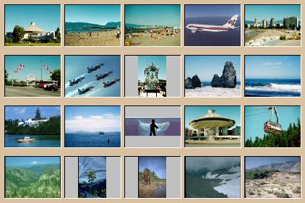


Mining Multimedia Databases
Refining or combining searches
Search for “airplane in blue sky” (top layout grid is blue and keyword = “airplane”)
Search for “blue sky and green meadows” (top layout grid is blue and bottom is green)
Search for “blue sky” (top layout grid is blue)

Slide 7

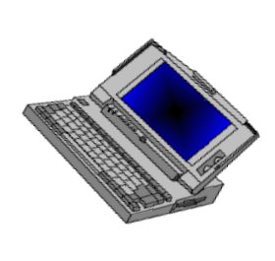

Text Mining
?
?
Internet

Slide 8
Text mining is the procedure of synthesizing information, by analyzing relations, patterns, and rules among textual data. These procedures contains text summarization, text categorization, and text clustering.
Text summarization is the procedure to extract its partial content reflecting its whole contents automatically.
Text categorization is the procedure of assigning a category to the text among categories predefined by users
Text clustering is the procedure of segmenting texts into several clusters, depending on the substantial relevance.

Slide 9
Text mining is well motivated, due to the fact that much of the world’s data can be found in free text form (newspaper articles, emails, literature, etc.).
There is a lot of information available to mine.
While mining free text has the same goals as data mining, in general, extracting useful knowledge/stats/trends), text mining must overcome a major difficulty – there is no explicit structure.

Slide 10
Machines can reason will relational data well since schemas are explicitly available.
Free text, however, encodes all semantic information within natural language.
Our text mining algorithms, then, must make some sense out of this natural language representation.
Humans are great at doing this, but this has proved to be a problem for machines.

Slide 11
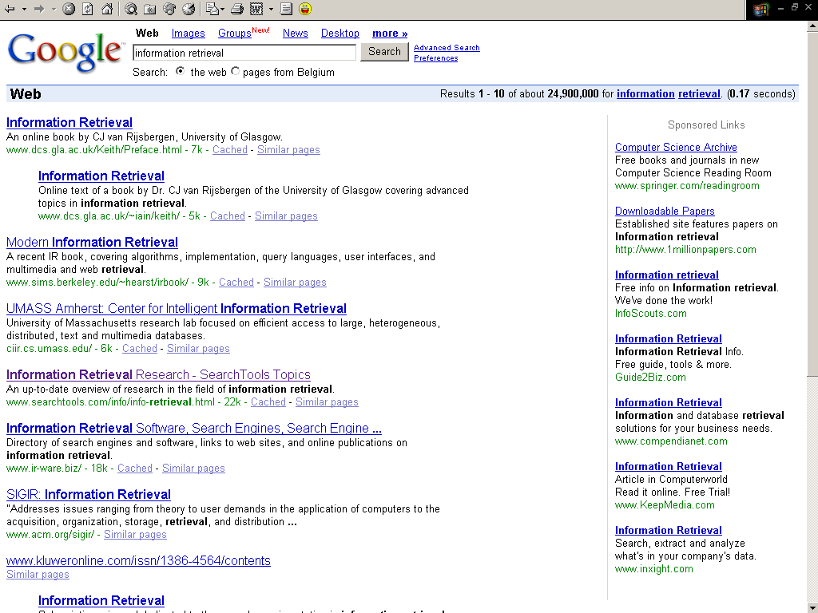

Slide 12
Application of Text Mining
Text mining system provides a competitive edge for a company to process and take advantage of a large quantity of textual information. The potential applications are countless. We highlight a few below.
Customer profile analysis, e.g., mining incoming emails for customers' complaint and feedback.
Patent analysis, e.g., analyzing patent databases for major technology players, trends, and opportunities.
Information dissemination, e.g., organizing and summarizing trade news and reports for personalized information services.
Company resource planning, e.g., mining a company's reports and correspondences for activities, status, and problems reported.

Slide 13
Text Mining vs. Data Mining
Data Mining Text Mining
Data Object Numerical & categorical data Textual data
Data structure Structured Unstructured &semi-structured
Data representation Straightforward Complex
Space dimension < tens of thousands > tens of thousands
Methods Data analysis, machine learning, Data mining, information
Statistic, neural networks retrieval, NLP, ...
Maturity Broad implementation since1994 Broad implementation
starting 2000
Market 10⁵ analysts at large and mid 10⁸ analysts corporate workers
size companies and individual users

Slide 14
Mining World Wide Web (WWW)
The term Web Mining was coined by Orem Etzioni (1996) to denote the use of data mining techniques to automatically discover Web documents and services, extract information from Web resources, and uncover general patterns on the Web.
The World Wide Web is a rich, enormous knowledge base that can be useful to many applications.

Slide 15
Mining World Wide Web (WWW)
The WWW is huge, widely distributed, global information service centre for news, advertisements, consumer information, financial management, education, government, e-commerce, hyperlink information, access and usage information.
The Web’s large size and its unstructured and dynamic content, as well as its multilingual nature make extracting useful knowledge from it a challenging research problem.

Slide 16
Why Mining the World-Wide Web
Growing and changing very rapidly
Broad diversity of user communities
Only a small portion of the information on the Web is truly relevant or useful
99% of the Web information is useless to 99% of Web users
How can we find high-quality Web pages on a specified topic?

Slide 17
Web Search Engines
Index-based: search the Web, index Web pages, and build and store huge keyword-based indices
Help locate sets of Web pages containing certain keywords
Deficiencies
A topic of any breadth may easily contain hundreds of thousands of documents
Many documents that are highly relevant to a topic may not contain keywords defining them (polysemy)

Slide 18
Web Mining: A More Challenging Task
Searches for
Web access patterns
Web structures
Regularity and dynamics of Web contents
Problems
The “abundance” problem
Limited coverage of the Web: hidden Web sources, majority of data in DBMS
Limited query interface based on keyword-oriented search
Limited customization to individual users

Slide 19
Web Mining Taxonomy
Web Mining
Web Content
Mining
Web Structure
Mining
Web Usage
Mining
Web Page
Content Mining
Search Result
Mining
General Access
Pattern Tracking
Customized
Usage Tracking

Slide 20
Web Mining Taxonomy
Web Mining research can be classified into three categories:
Web content mining refers to the discovery of useful information from Web contents, including text, images, audio, video, etc.
Web structure mining studies the model underlying the link structures of the Web. It has been used for search engine result ranking and other Web applications.
Web usage mining focuses on using data mining techniques to analyze search logs to find interesting patterns. One of the main applications of Web usage mining is its use to learn user profiles.

Slide 21
Mining the World-Wide Web
Web Mining
Web Content
Mining
Web Structure
Mining
Web Usage
Mining
Web Page Content Mining
Web Page Summarization
WebLog (Lakshmanan et.al. 1996), WebOQL(Mendelzon et.al. 1998) …:
Web Structuring query languages;
Can identify information within given web pages
Ahoy! (Etzioni et.al. 1997):Uses heuristics to distinguish personal home pages from other web pages
ShopBot (Etzioni et.al. 1997): Looks for product prices within web pages
Search Result
Mining
General Access
Pattern Tracking
Customized
Usage Tracking

Slide 22
Mining the World-Wide Web
Web Mining
Web Content
Mining
Web Structure
Mining
Web Usage
Mining
Web Page
Content Mining
Search Result Mining
Search Engine Result Summarization
Clustering Search Result (Leouski and Croft, 1996, Zamir and Etzioni, 1997):
Categorizes documents using phrases in titles and snippets
General Access
Pattern Tracking
Customized
Usage Tracking

Slide 23
Mining the World-Wide Web
Web Mining
Web Content
Mining
Web Usage
Mining
Web Structure Mining
Using Links
PageRank (Brin et al., 1998)
CLEVER (Chakrabarti et al., 1998)
Use interconnections between web pages to give weight to pages.
Using Generalization
MLDB (1994), VWV (1998)
Uses a multi-level database representation of the Web. Counters (popularity) and link lists are used for capturing structure.
Search Result
Mining
General Access
Pattern Tracking
Web Page
Content Mining
Customized
Usage Tracking

Slide 24
Mining the World-Wide Web
Web Mining
Web Content
Mining
Web Structure
Mining
Web Usage
Mining
Web Page
Content Mining
General Access Pattern Tracking
Web Log Mining (Zaïane, Xin and Han, 1998)
Uses KDD techniques to understand general access patterns and trends.
Can shed light on better structure and grouping of resource providers.
Customized
Usage Tracking
Search Result
Mining

Slide 25
Mining the World-Wide Web
Web Mining
Web Content
Mining
Web Structure
Mining
Web Usage
Mining
Web Page
Content Mining
General Access
Pattern Tracking
Customized Usage Tracking
Adaptive Sites (Perkowitz and Etzioni, 1997)
Analyzes access patterns of each user at a time.
Web site restructures itself automatically by learning from user access patterns.
Search Result
Mining

Slide 26
Web Usage Mining
Web servers, Web proxies, and client applications can quite easily capture Web Usage data.
Web server log: Every visit to the pages, what and when files have been requested, the IP address of the request, the error code, the number of bytes sent to user, and the type of browser used.
By analyzing the Web usage data, web mining systems can discover useful knowledge about a system’s usage characteristics and the users’ interests which has various applications:
Personalization and Collaboration in Web-based systems
Marketing
Web site design and evaluation
Decision support

Slide 27
Mining Web log records to discover user access patterns of Web pages
Applications
Target potential customers for electronic commerce
Enhance the quality and delivery of Internet information services to the end user
Improve Web server system performance
Identify potential prime advertisement locations
Web logs provide rich information about Web dynamics
Typical Web log entry includes the URL requested, the IP address from which the request originated, and a timestamp

Slide 28
Why Web Usage Mining?
Explosive growth of E-commerce
Provides an cost-efficient way doing business
Amazon.com: “online Wal-Mart”
Hidden Useful information
Visitors’ profiles can be discovered
Measuring online marketing efforts, launching marketing campaigns, etc.
One of the major goals of Web usage mining is to reveal interesting trends and patterns which can often provide important knowledge about the users of a system.

Slide 29
Many Web applications aim to provide personalized information and services to users. Web usage data provide an excellent way to learn about users’ interest.
WebWatcher (Armstrong et al., 1995)
Letizia (Lieberman, 1995)
Web usage mining on Web logs can help identify users who have accessed similar Web pages. The patterns that emerge can be very useful in collaborative Web searching and filtering.
Amazon.com uses collaborative filtering to recommend books to potential customers based on the preferences of other customers having similar interests or purchasing histories.
Huang et al. (2002) used Hopfield Net to model user interests and product profiles in an online bookstore in Taiwan.

Slide 30
How to perform Web Usage Mining
Obtain web traffic data from
Web server log files
Corporate relational databases
Registration forms
Apply data mining techniques and other Web mining techniques
Two categories:
Pattern Discovery Tools
Pattern Analysis Tools

Slide 31
Web Content Mining
Web Content Mining is the process of extracting useful information from the contents of Web documents.
Content data corresponds to the collection of facts a Web page was designed to convey to the users.
May consist of text, images, audio, video, or structured records such as lists and tables.
Web content has been the most widely researched.
Issues addressed in text mining are, topic discovery, extracting association patterns, clustering of web documents and classification of Web Pages.

Slide 32
Web Content Mining
Text Mining for Web Documents
Text mining for Web documents can be considered a sub-field of Web content mining.
Information extraction techniques have been applied to Web HTML documents
Text clustering algorithms also have been applied to Web applications.

Slide 33
Web Structure Mining
Web link structure has been widely used to infer important web pages information.
Web structure mining has been largely influenced by research in
Social network analysis
Citation analysis (bibliometrics).
in-links: the hyperlinks pointing to a page
out-links: the hyperlinks found in a page.
Usually, the larger the number of in-links, the better a page is.
By analyzing the pages containing a URL, we can also obtain
Anchor text: how other Web page authors annotate a page and can be useful in predicting the content of the target page.

Slide 34
Web structure mining algorithms:
The PageRank algorithm is computed by weighting each in-link to a page proportionally to the quality of the page containing the in-link.
The qualities of these referring pages also are determined by PageRank.
Kleinberg (1998) proposed the HITS (Hyperlink-Induced Topic Search) algorithm, which is similar to PageRank.
Authority pages: high-quality pages related to a particular search query.
Hub pages: pages provide pointers to other authority pages.

Slide 35
Conclusion
Multimedia data mining needs content-based retrieval and similarity search integrated with mining methods
Text mining goes beyond keyword-based and similarity-based information retrieval and discovers knowledge from semi-structured data using methods like keyword-based association and document classification.
Web mining includes mining Web link structures to identify authoritative Web pages, the automatic classification of Web documents, building a multilayered Web information base, and Weblog mining.

Slide 36
Thank you !!!

